Slide 1
Neural Network Based Digital Twin for a Half-bridge LLC Resonant Converter
Master’s Thesis Defense April 29th, 2024
University at Albany, College of Nanoscale, Science, and Engineering
Nicholas Green
Advisor: Professor Agamy
Committee Members: Professor Elgala, Professor Dahlin

Slide 2
Outline
Introduction
Previous Works
Converter Model
Data collection and Simulations
Neural Networks
Digital Twin Design
Results/Discussion
Conclusion and Future Work

Slide 3
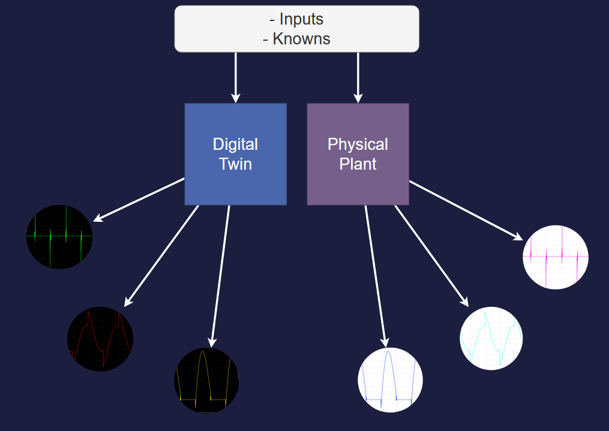
Introduction
Ideal Digital Twins can fully emulate a real system only using the same inputs

Slide 4
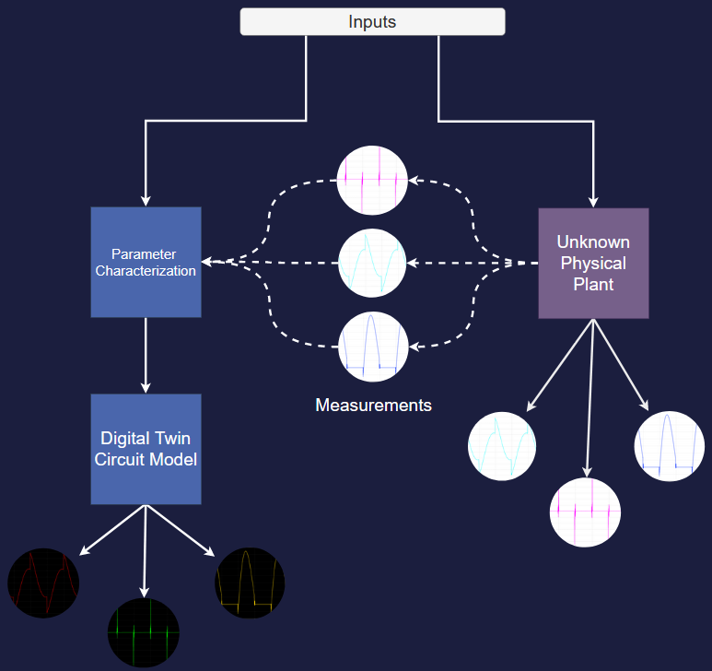
Introduction
Unknown internal parameters requires some measurements
Digital Twin characterizes and them emulates

Slide 5
Previous Work
Data Driven
Model Based
Meta Heuristics
Averaged
Models
Offline Data collection
Outputs/Control predictions
Unknown or Partially Unknown parameters
Machine Learning
Stochastic
Unknown parameters
Online Data
Particle Swarm Optimization
Known Parameters
Output Prediction

Slide 6
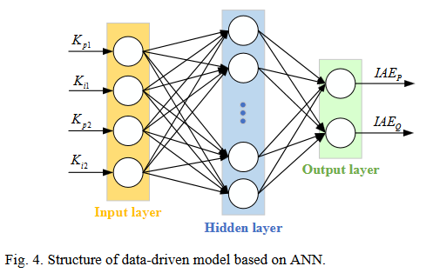
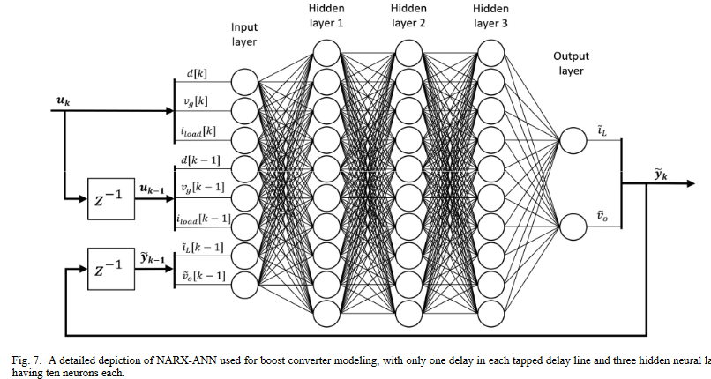
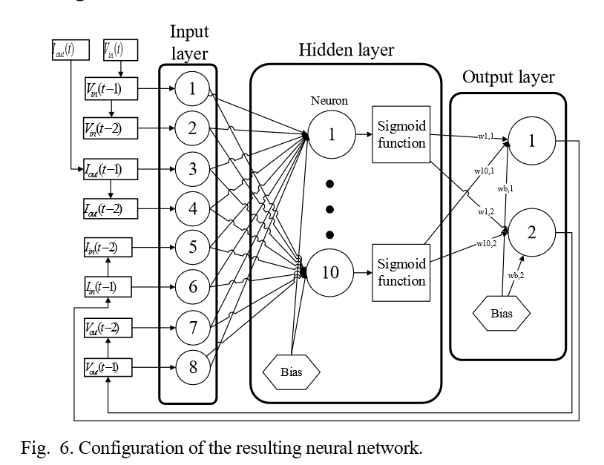
Previous Work
Inputs: Control Gains
Outputs: Reference Error
Inputs: Duty Cycle, Input Voltage, Load Current, past predictions
Outputs: Inductor Current, Output Voltage
Inputs: Input Voltage, Output Current, Past predictions
Outputs: Input Current, Output Voltage
X. Cheng, J. Chen, Y. Chen, X. Zhao, Z. Zhou, Q. Yang, and N. Y. Dai, “Digital-Twin- Driven PI Parameter Evaluation Method for Grid-Connected Converters,” in 2023 4th International Conference on Power Engineering (ICPE), (Macau, Macao), pp. 26–31, IEEE, Dec. 2023.
A. Wunderlich and E. Santi, “Digital Twin Models of Power Electronic Converters Using Dynamic Neural Networks,” in 2021 IEEE Applied Power Electronics Conference and Exposition (APEC), (Phoenix, AZ, USA), pp. 2369–2376, IEEE, June 2021.
G. Rojas-Duenas, J.-R. Riba, K. Kahalerras, M. Moreno-Eguilaz, A. Kadechkar, and A. Gomez-Pau, “Black-Box Modelling of a DC-DC Buck Converter Based on a Recur- rent Neural Network,” in 2020 IEEE International Conference on Industrial Technology (ICIT), (Buenos Aires, Argentina), pp. 456–461, IEEE, Feb. 2020

Slide 7
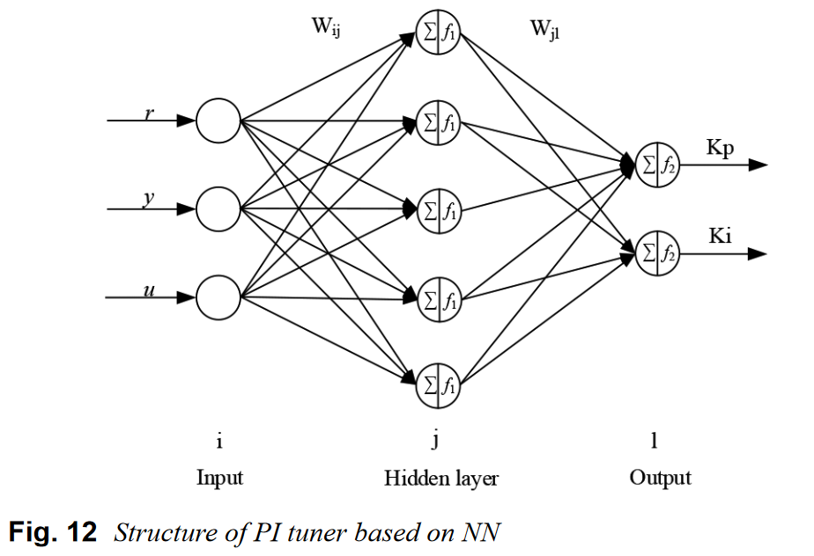
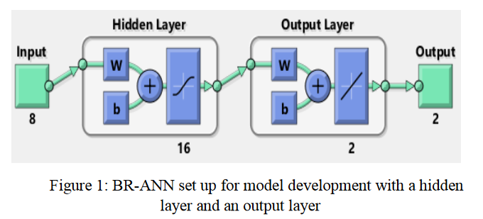
Previous Work
Inputs: Input Voltage, Duty Cycle, Frequency, Load Resistance, Inductor, Cap actor, Time (ms), Initial Output Capacitor Voltage
Outputs: Output Voltage, Inductor Current
Inputs: Reference, output, inputs
Outputs: PI gains
H. S. Krishnamoorthy and T. Narayanan Aayer, “Machine Learning based Modeling of Power Electronic Converters,” in 2019 IEEE Energy Conversion Congress and Exposi- tion (ECCE), (Baltimore, MD, USA), pp. 666–672, IEEE, Sept. 2019.
X. Song, T. Jiang, S. Schlegel, and D. Westermann, “Parameter tuning for dynamic dig- ital twins in inverter-dominated distribution grid,” IET Renewable Power Generation, vol. 14, pp. 811–821, Apr. 2020

Slide 8
Thesis Goals
Converter Characterization with Machine Learning
Increased Complexity
More accurate switch model/dynamics

Slide 9
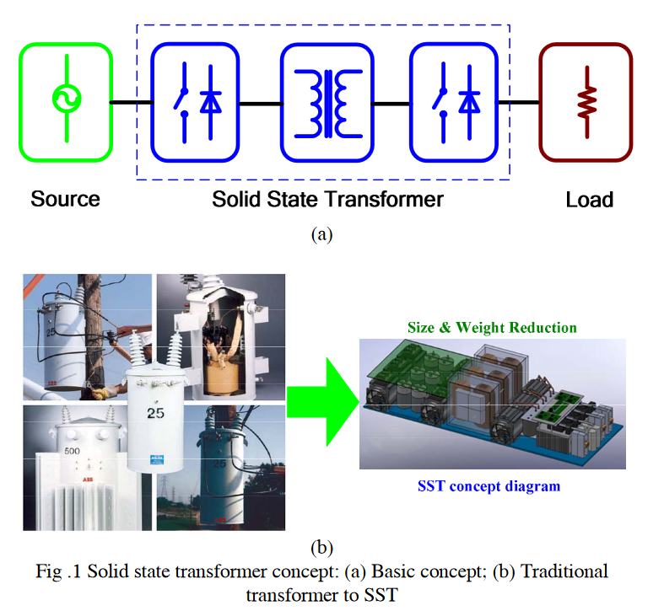
Solid State Transformers
Solid State Transformers take the place of normal transformers
They offer improvements in weight, and size
Due to the architecture, greater control can be implemented such as:
Voltage sag control
Limiting current into faults
DC output
Xu She and A. Huang, “Solid state transformer in the future smart electrical system,”
in 2013 IEEE Power & Energy Society General Meeting, (Vancouver, BC), pp. 1–5,
IEEE, 2013

Slide 10
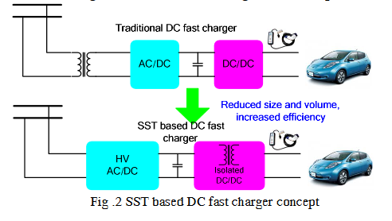
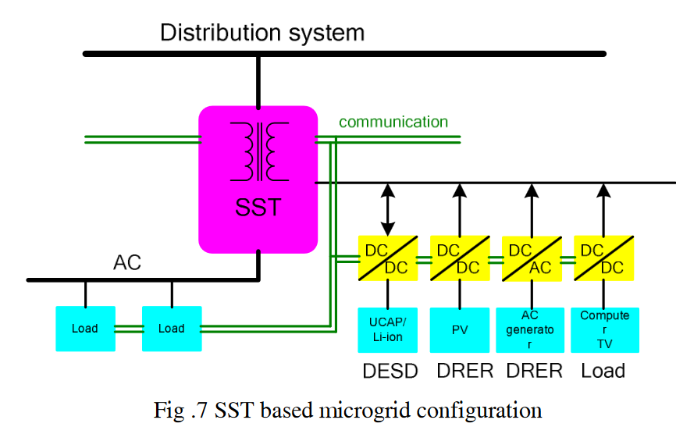
Solid State Transformers
Xu She and A. Huang, “Solid state transformer in the future smart electrical system,”
in 2013 IEEE Power & Energy Society General Meeting, (Vancouver, BC), pp. 1–5,
IEEE, 2013

Slide 11
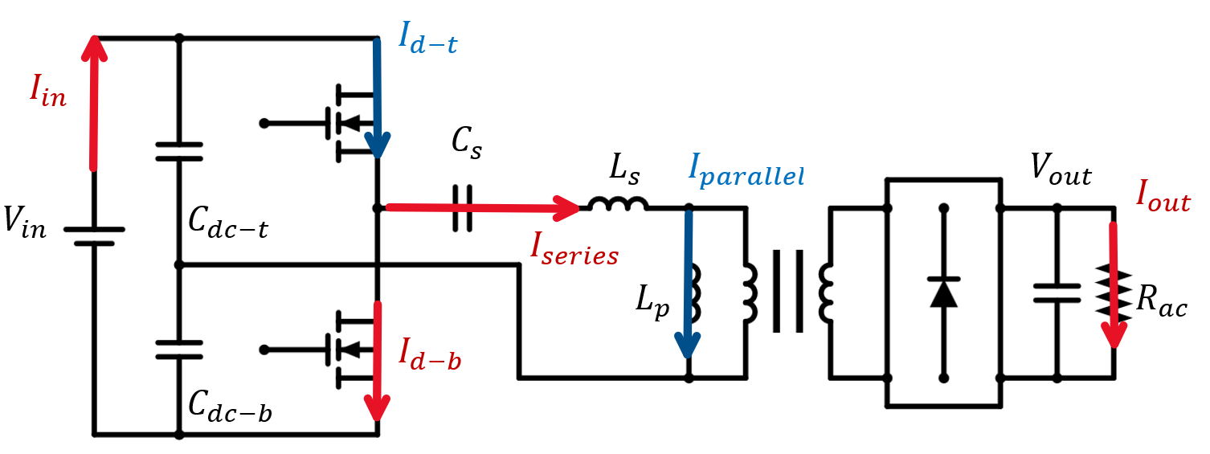
Half-Bridge LLC Resonant Converter

Slide 12
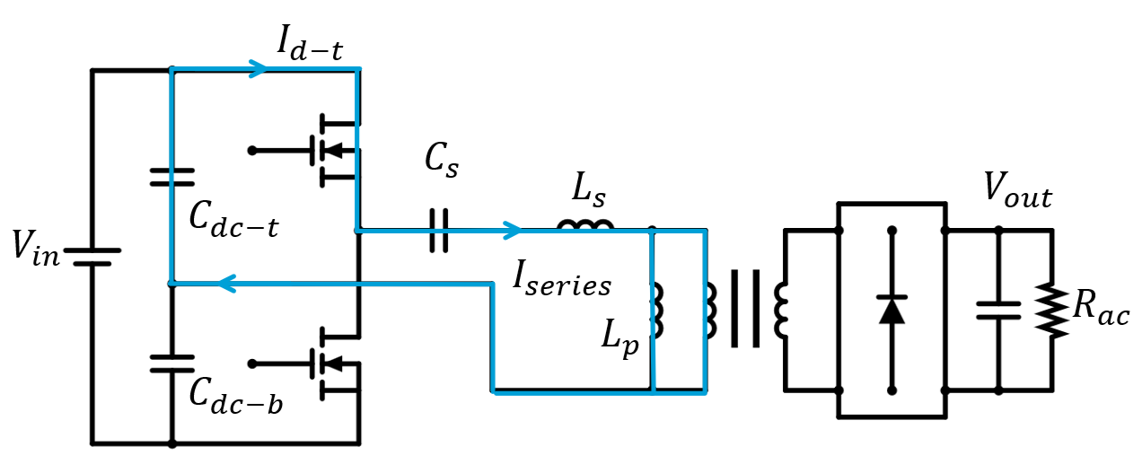
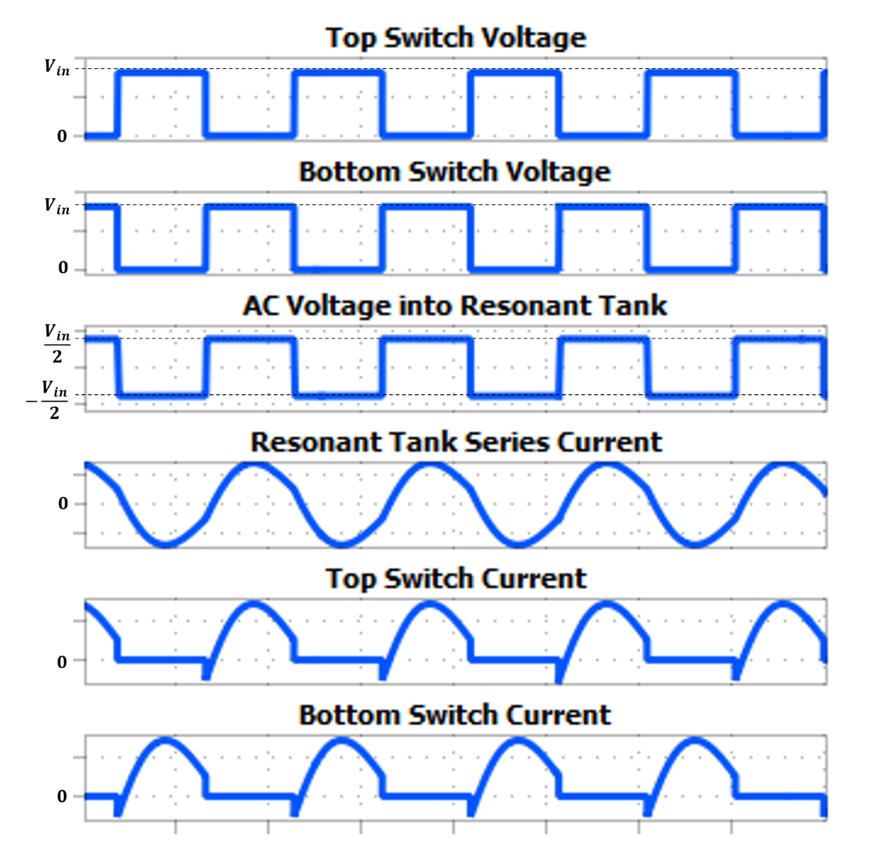
Converter Operation: Top Switch On

Slide 13
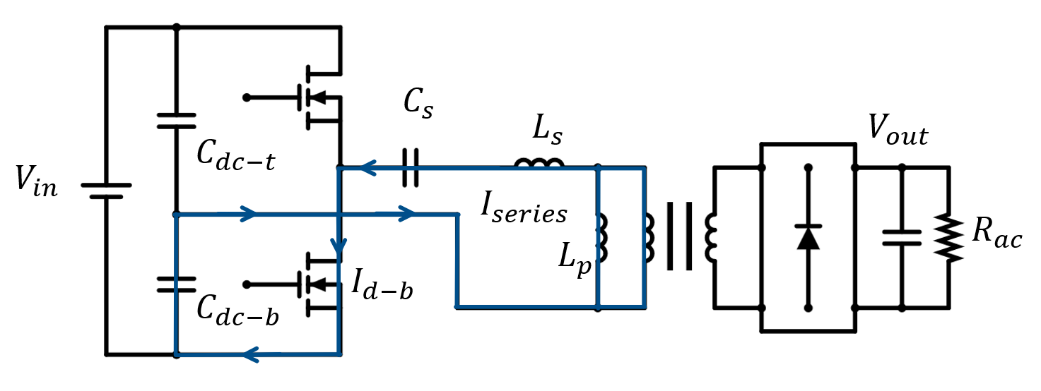
Converter Operation: Bottom Switch On

Slide 14
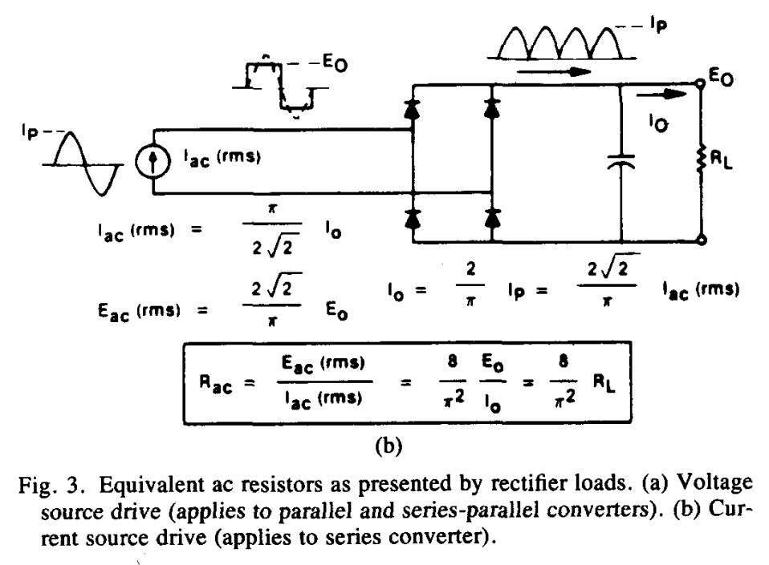
Converter Modeling
Take the perspective of looking into the rectifier
Constant DC output voltage reverses to AC Square wave voltage (taking the fundamental approximation)
AC Current expected from resonant converters. Use fundamental AC approximation
Find equivalent resistance using current and voltage reversed through the rectifier
Finally, account for transformer turns ratio
R. Steigerwald, “A comparison of half-bridge resonant converter topologies,” IEEE
Transactions on Power Electronics, vol. 3, pp. 174–182, Apr. 1988.

Slide 15
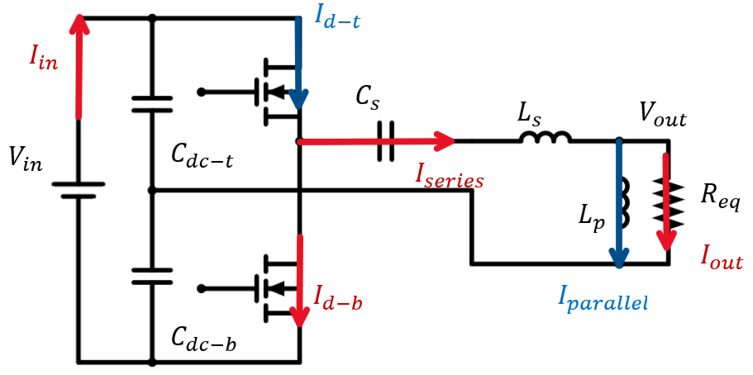
Converter Modeling

Slide 16
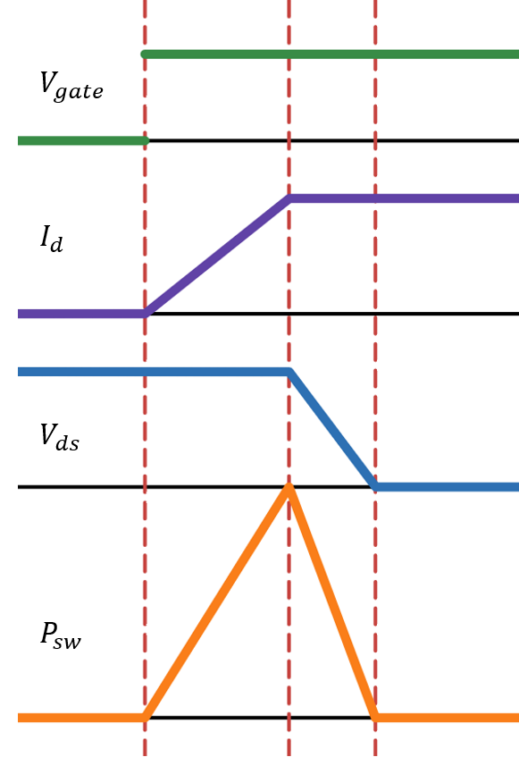
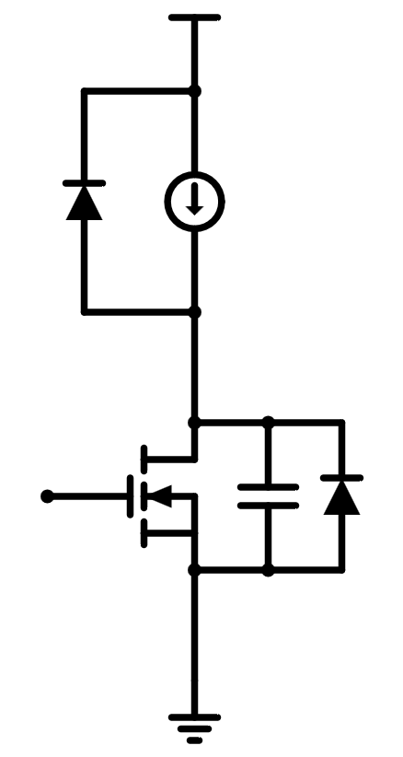
Inductive Switching
Example of a switch Hard-Switching at Turn On causing switching losses
Turn-On rising current along with the voltage across the switch leads to power losses that increase with frequency limiting power density

Slide 17
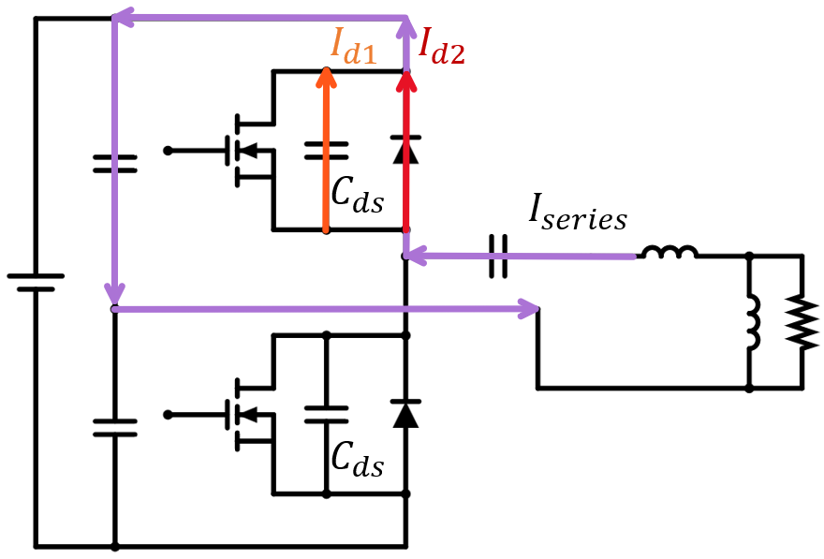
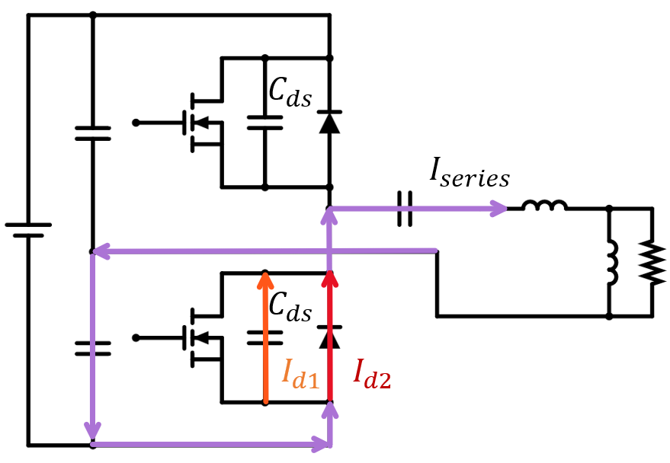
Zero Voltage Switching
Induce Zero Voltage Soft Switching by switching frequency higher than the resonant tank’s natural frequency such that the tank is more “inductive” and lags current such that before switch turn-on, the resonant current discharges the voltage during deadtime

Slide 18


Converter Modeling
$G=\frac{jX_{L_{p}}∥R_{eq}}{jX_{L_{p}}∥R_{eq}−jX_{C}+jX_{L_{s}}}$
$$G=\frac{1}{\left(1−\frac{1}{ω_{s}^{2}CL_{p}}+\frac{L_{s}}{L_{p}}\right)+j\left(ω_{s}\frac{L_{s}}{R_{eq}}−\frac{1}{ωCR_{eq}}\right)}$$

Slide 19



Converter Modeling
$$G=\frac{1}{\left(1−\frac{1}{ω_{s}^{2}CL_{p}}+\frac{L_{s}}{L_{p}}\right)+j\left(ω_{s}\frac{L_{s}}{R_{eq}}−\frac{1}{ω_{s}CR_{eq}}\right)}$$
Define:
$Q=\frac{X_{c}}{R_{eq}}$
$ω_{0}=\frac{1}{\sqrt{CL_{p}}}$
$$G=\frac{1}{\left(1−{\left(\frac{ω_{0}}{ω_{s}}\right)}^{2}+\frac{L_{s}}{L_{p}}\right)+jQ\left({\left(\frac{ω_{0}}{ω_{s}}\right)}^{2}\frac{L_{s}}{L_{p}}−1\right)}$$

Slide 20

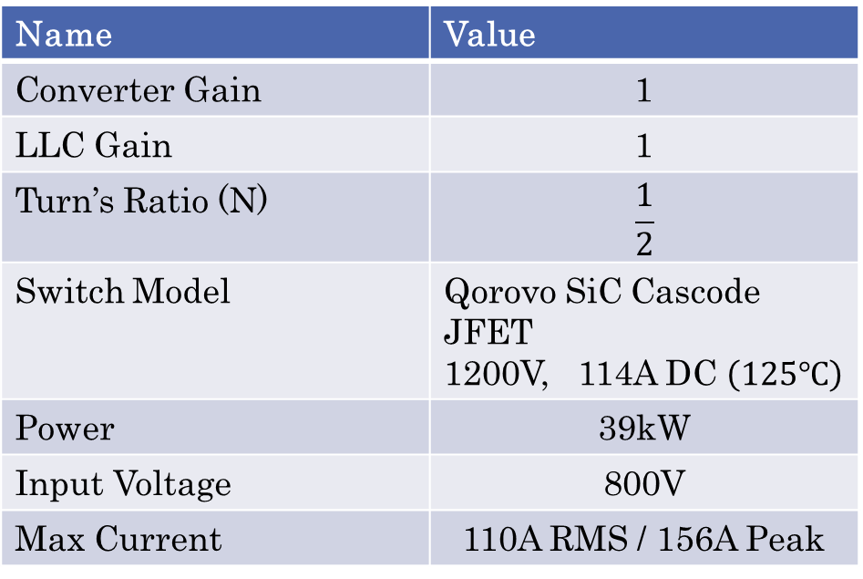


Converter Modeling
Name | Value
Converter Gain | 1
LLC Gain | 1
Turn’s Ratio (N) | $$\frac{1}{2}$$
Switch Model | Qorovo SiC Cascode JFET 1200V, 114A DC $\left(125℃\right)$
Power | 39kW
Input Voltage | 800V
Max Current | 110A RMS / 156A Peak
$$G=\frac{1}{\left(1−{\left(\frac{ω_{0}}{ω_{s}}\right)}^{2}+\frac{L_{s}}{L_{p}}\right)+jQ\left({\left(\frac{ω_{0}}{ω_{s}}\right)}^{2}\frac{L_{s}}{L_{p}}−1\right)}$$
Define:
$L_{ratio}=\frac{L_{s}}{L_{p}}$
$ω_{ratio}=\frac{ω_{0}}{ω_{s}}$
$$G=\frac{1}{\left(1−ω_{ratio}^{2}+L_{ratio}\right)+jQ\left(ω_{ratio}^{2}L_{ratio}−1\right)}$$

Slide 21
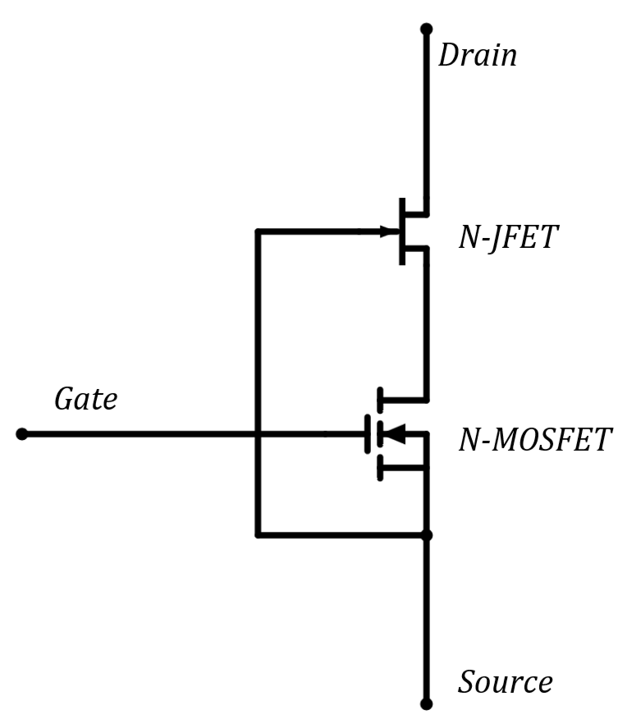
Converter Modeling
Name | Value
Converter Gain | 1
LLC Gain | 1
Turn’s Ratio (N) | $$\frac{1}{2}$$
Switch Model | Qorovo SiC Cascode JFET 1200V, 114A DC $\left(125℃\right)$
Power | 39kW
Input Voltage | 800V
Max Current | 110A RMS / 156A Peak

Slide 22
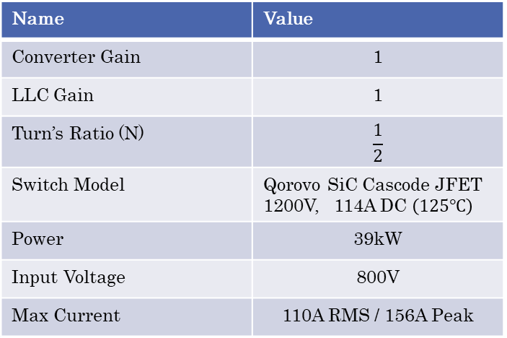

Converter Modeling
Name | Value
Converter Gain | 1
LLC Gain | 1
Turn’s Ratio (N) | $$\frac{1}{2}$$
Switch Model | Qorovo SiC Cascode JFET 1200V, 114A DC $\left(125℃\right)$
Power | 39kW
Input Voltage | 800V
Max Current | 110A RMS / 156A Peak
$$I_{max}>\frac{V_{max}}{|Z_{tank}|}$$
$$I_{max}>\frac{\frac{1}{R_{eq}}\left(\frac{w_{ratio}^{2}}{Q}+j\right)}{Q\left(1−\frac{L_{ratio}}{w_{ratio}^{2}}\right)+j\left(1−w_{ratio}^{2}+L_{ratio}\right)}$$

Slide 23
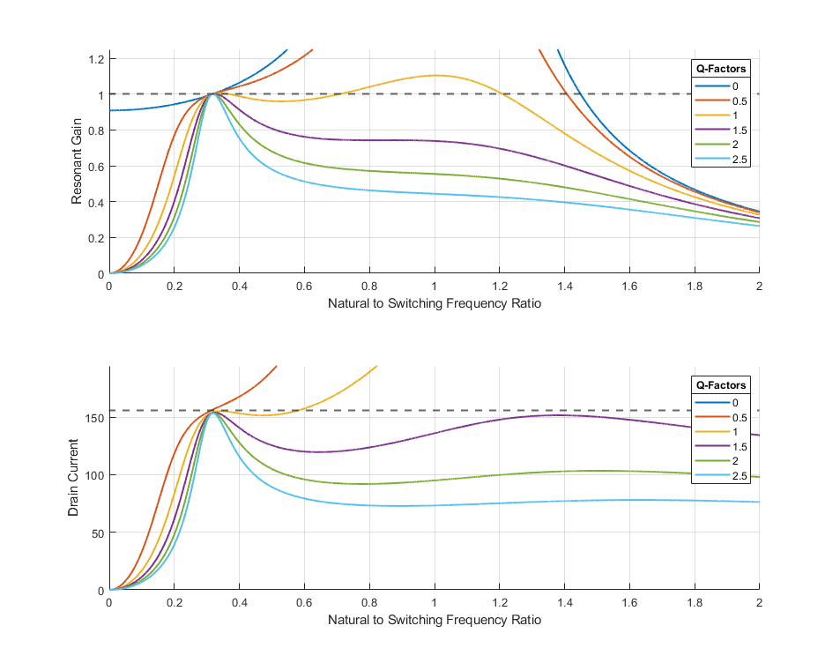
Converter Modeling
Name | Value
Converter Gain | 1
LLC Gain | 1
Turn’s Ratio (N) | $$\frac{1}{2}$$
Switch Model | Qorovo SiC Cascode JFET 1200V, 114A DC $\left(125℃\right)$
Power | 39kW
Input Voltage | 800V
Max Current | 110A RMS / 156A Peak

Slide 24
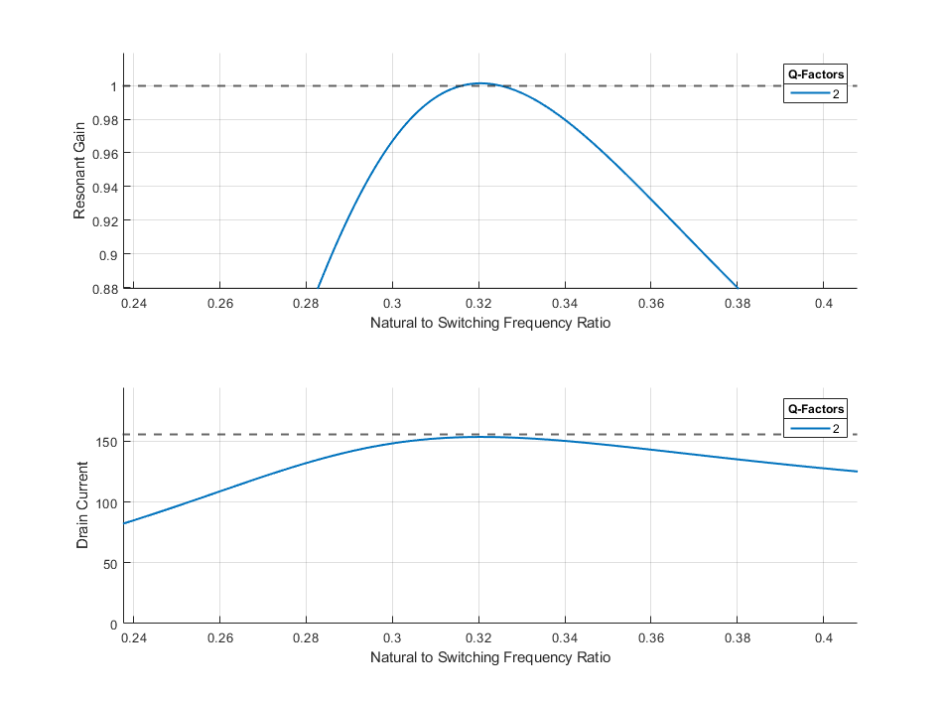
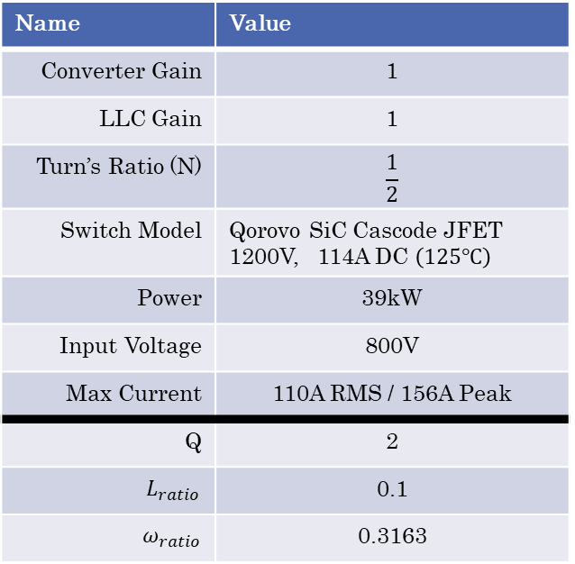
Converter Modeling
Name | Value
Converter Gain | 1
LLC Gain | 1
Turn’s Ratio (N) | $$\frac{1}{2}$$
Switch Model | Qorovo SiC Cascode JFET 1200V, 114A DC $\left(125℃\right)$
Power | 39kW
Input Voltage | 800V
Max Current | 110A RMS / 156A Peak
Q | 2
$$L_{ratio}$$ | 0.1
$$ω_{ratio}$$ | 0.3163

Slide 25
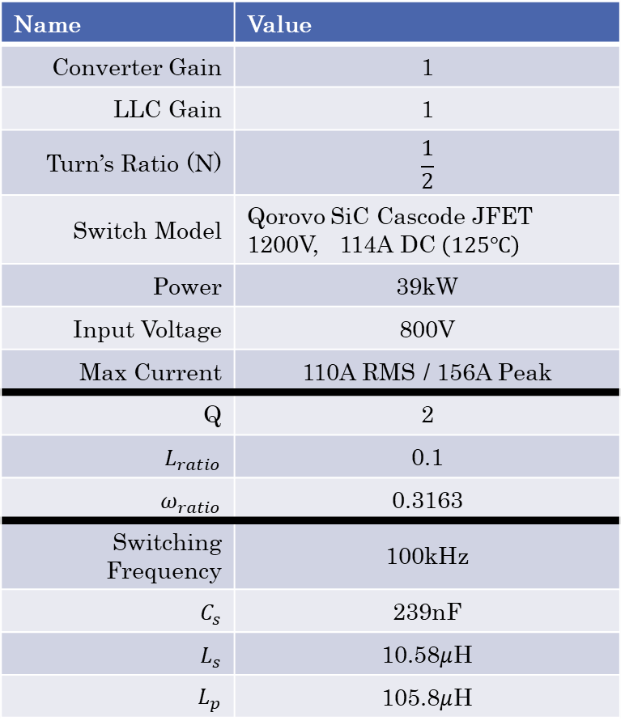

Converter Modeling
Name | Value
Converter Gain | 1
LLC Gain | 1
Turn’s Ratio (N) | $$\frac{1}{2}$$
Switch Model | Qorovo SiC Cascode JFET 1200V, 114A DC $\left(125℃\right)$
Power | 39kW
Input Voltage | 800V
Max Current | 110A RMS / 156A Peak
Q | 2
$$L_{ratio}$$ | 0.1
$$ω_{ratio}$$ | 0.3163
Switching Frequency | 100kHz
$$C_{s}$$ | 239nF
$$L_{s}$$ | 10.58$μ$H
$$L_{p}$$ | 105.8$μ$H
$$R_{eq}=\frac{8}{π^{2}}N^{2}\frac{V_{out}^{2}}{P}=3.325Ω$$
$$C_{s}=\frac{1}{2πf_{sw}\left(QR_{eq}\right)}=\frac{1}{2π\left(100kHz\right)\left(2∗3.325Ω\right)}=239nF$$
$$L_{p}=\frac{X_{c}}{ω_{ratio}^{2}ω_{s}}=\frac{\left(2∗3.325Ω\right)}{{\left(0.3163\right)}^{2}∗2π(100kHz)}=105.8μH$$
$$L_{s}=L_{ratio}L_{p}=10.58μH$$

Slide 26
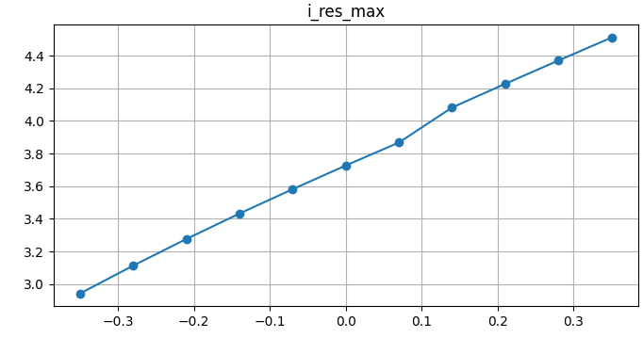
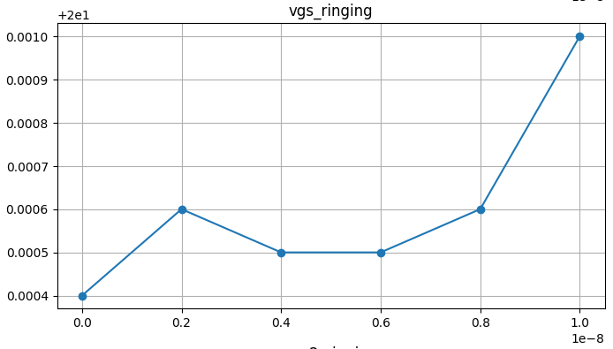
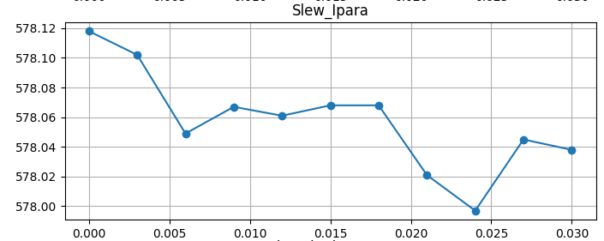



Data Collection: Experiments
$I_{series} Max$ vs $C_{s}$ $\left(±35\%\right)$
$V_{gs} Ringing$ vs $C_{gs}$ $\left(+0→10nF\right)$
$V_{L_{p}}/V_{out} Max$ vs $R_{ds−on}$ in both
$$\left(+0→30mΩ\right)$$
Manual Sweeps of parameters were done to get an idea of how changes in some parameters effect measurable parameters.
These can help eliminate negligible parameters to sweep to reduce the simulation time
They can help guide the input selection for more accurate predictions

Slide 27

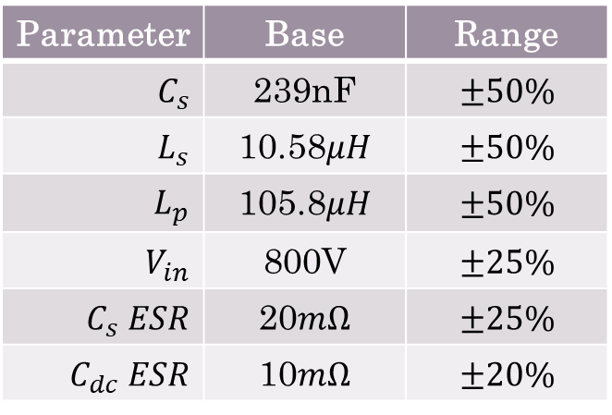
Data Collection
Parameter | Base | Range
$$C_{s}$$ | 239nF | $$±50\%$$
$$L_{s}$$ | 10.58$μH$ | $$±50\%$$
$$L_{p}$$ | 105.8$μH$ | $$±50\%$$
$$V_{in}$$ | 800V | $$±25\%$$
$$C_{s} ESR$$ | 20$mΩ$ | $$±25\%$$
$$C_{dc} ESR$$ | 10$mΩ$ | $$±20\%$$
Passives go beyond the 5-20% tolerances range. Data on degradation
$V_{in}$ needs to vary around it operating point
$C_{s}$ ESR taken from real model 220nF film capacitor in lab. Small range around this chosen
$C_{dc}$ ESR taken from large DC-Link Capacitors in lab. Small range around this chosen

Slide 28

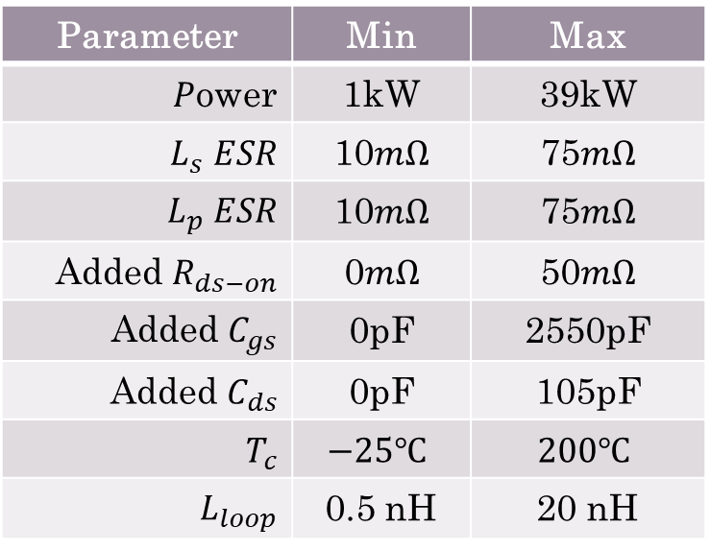
Data Collection
Parameter | Min | Max
$P$ower | 1kW | 39kW
$$L_{s} ESR$$ | 10$mΩ$ | 75$mΩ$
$$L_{p} ESR$$ | 10$mΩ$ | 75$mΩ$
Added $R_{ds−on}$ | 0$mΩ$ | 50$mΩ$
Added $C_{gs}$ | 0pF | 2550pF
Added $C_{ds}$ | 0pF | 105pF
$$T_{c}$$ | $$−25℃$$ | $$200℃$$
$$L_{loop}$$ | 0.5 nH | 20 nH
Power range ideally is 0 to full power. Lower limit of 1kW chosen as going lower than that break the converter
Inductor ESR’s chosen in range to account for thermal increases in resistance of copper
$R_{ds−on}$ range based on switch degradation data plus an additional buffer
Added switch capacitance 30% of datasheet value
Case temps using wide range as thermal simulations are fast
Loop inductance in small range, represents parasitic inductance real connections

Slide 29
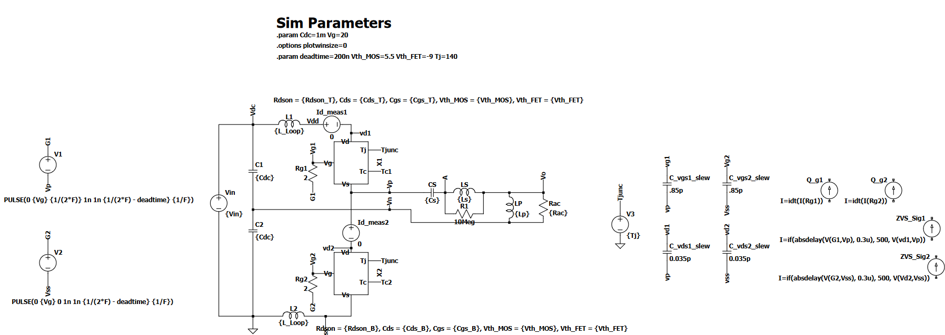
Simulation Setup

Slide 30
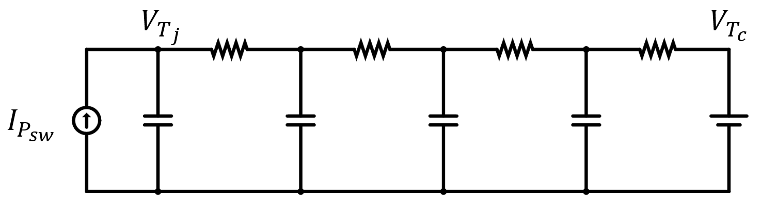

Thermal Approximation
Real Thermal Simulations take too long to reach steady state
(Switch Losses $→$ Junction Temperature)
Instead force an approximate junction temperature to get the corresponding switch losses. Junction temperature was chosen to be in the middle. Ignores self heating effects, and ZVS loss.
(Junction Temperature $→$ Switching Loss $→$ Final Junction Temperature)

Slide 31

Simulation Setup
Solving the gain $\left(G=1\right)$ equation for angular frequency and using numerical solvers, you can find the optimal frequency
To ensure ZVS, choose the max frequency out of all real solutions
$$ω^{6}\left[\frac{L_{s}^{2}}{R_{ac}^{2}}\right]+ω^{4}\left[{\left(\frac{L_{s}}{L_{p}}\right)}^{2}+2\frac{L_{s}}{L_{p}}+1−\frac{1}{G^{2}}−2\frac{L_{s}}{CR_{ac}^{2}}\right]+ω^{2}\left[\frac{1}{C^{2}R_{ac}^{2}}−2\frac{L_{s}}{CL_{p}^{2}}−2\frac{1}{CL_{p}}\right]+\left[\frac{1}{C^{2}L_{p}^{2}}\right]=0$$

Slide 32

Initial Conditions
$$Z_{1}=X_{c}+X_{s}$$
$$Z_{2}=X_{L_{p}}∥R_{eq}$$
$$I_{series}=\frac{V_{max}}{Z_{1}+Z_{2}}$$
$$V_{C_{s}}=I_{s}X_{c}$$
$$V_{L_{s}}=I_{s}X_{L_{s}}$$
$$V_{out}=V_{max}∗G=V_{max}∗\frac{Z_{2}}{Z_{1}+Z_{2}}$$
$$I_{p}=\frac{V_{out}}{X_{L_{p}}}$$
Simulating 4 cycles, 1 to adjust and 3 to measure
Without initial conditions, steady state took about 3x more cycles to achieve

Slide 33
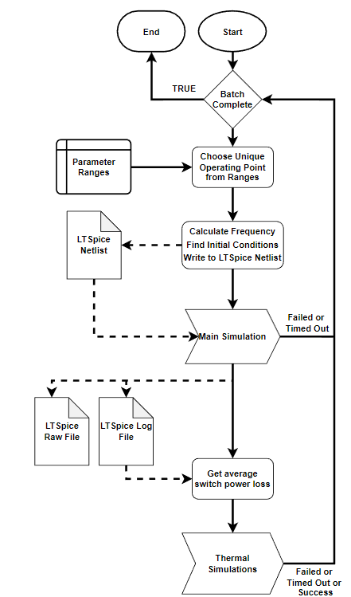
Simulations
Repeating over a range of simulations, a random configuration is selected from the parameter ranges
This configuration is simulated with checks on success, duplicated simulation, and timeout triggers
Both thermal simulations are conducted in the same manner with first finding the average switch powers from the main simulation

Slide 34
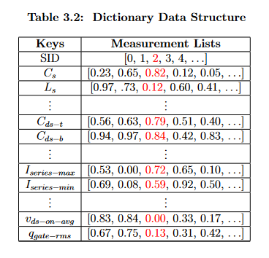
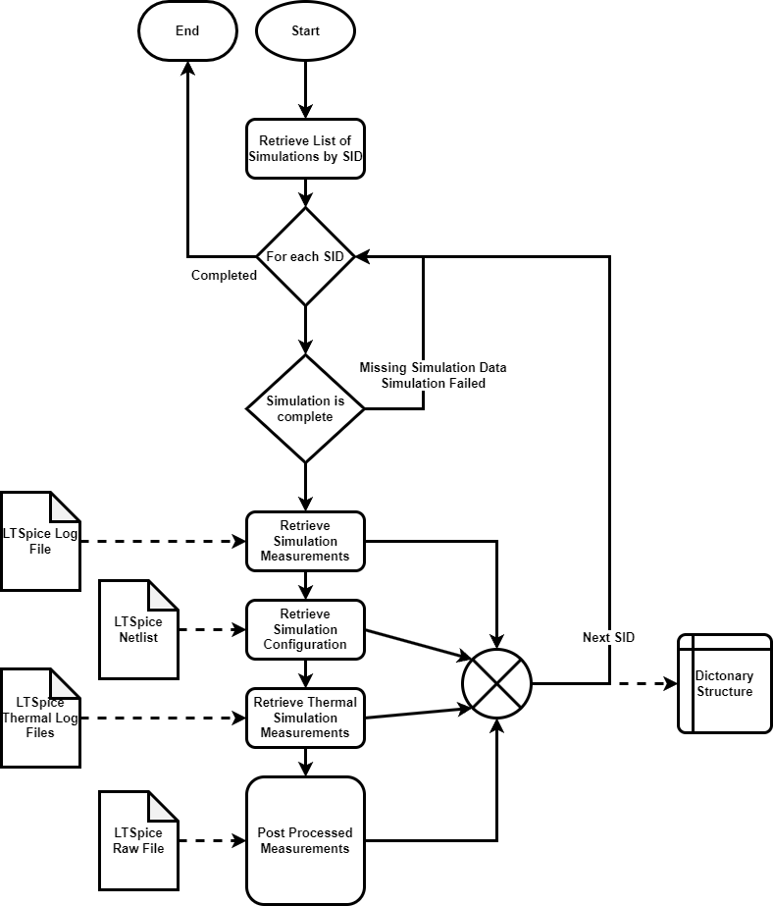
Data Collection
Iterating over all successful simulations, data is gathered from the respective files, (if needed) a post-processing step is done last , and data is formatted into a dataset with a dictionary structure
Just over 6000 sample size dataset

Slide 35
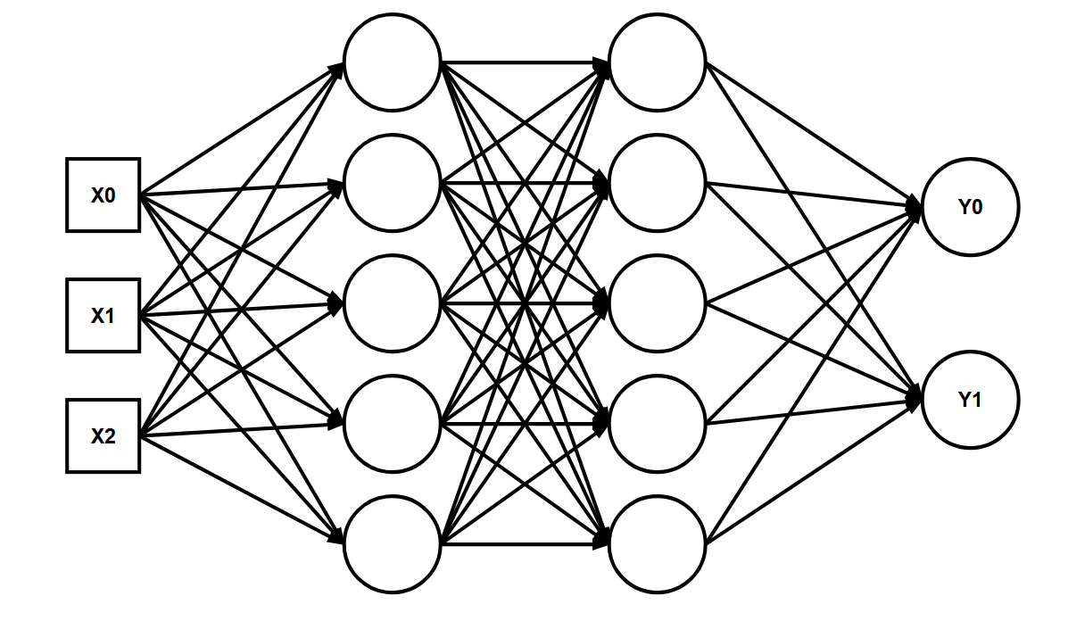
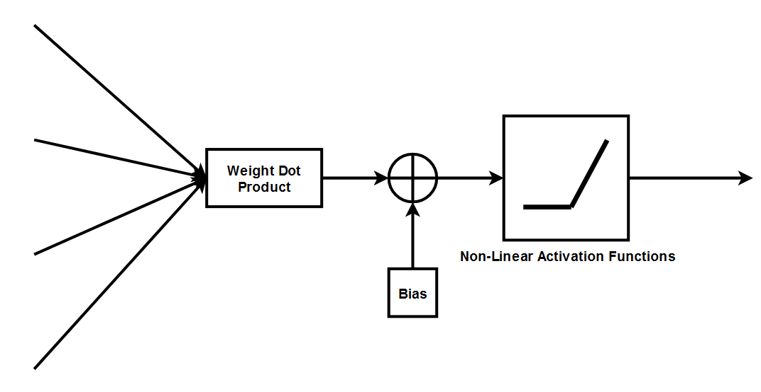
Neural Networks
Basic Fully Connected Neural Network structure with only an input and output layer. Hidden layers with any size, can be added
Perceptron block diagram where the inner product of the input vector (from all previous perceptrons), and the weight vector is done, added to a bias and passed through a non-linear activation function
Weights, and biases are trainable parameters
The activation function and network structure is a hyperparameters

Slide 36
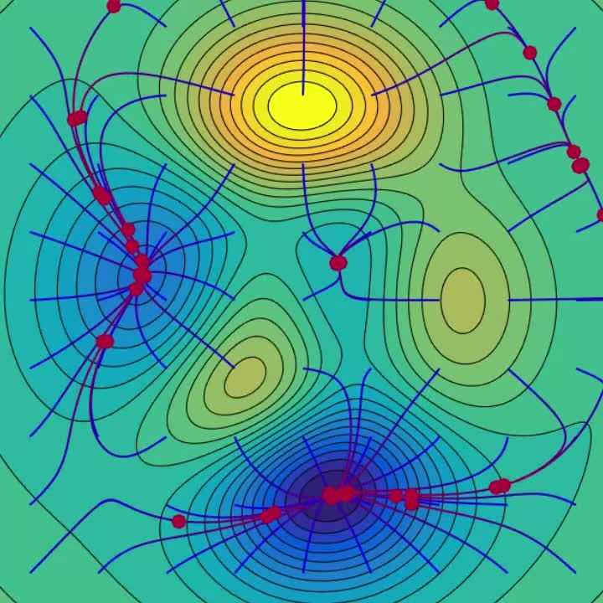
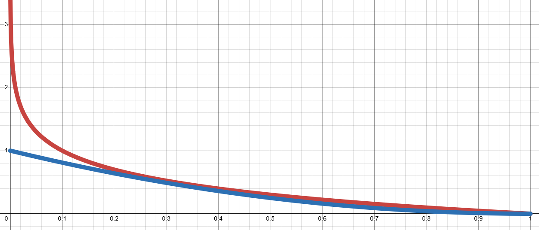


Training with Gradient Descent
$$w_{t+1}=w_{t}+α\frac{δ}{δw_{t}}L\left(y_{t}, {\hat{y}}_{i}\right)$$
Loss Functions
$$MSE=\frac{1}{N}\sum{{\left(y_{i}−{\hat{y}}_{i}\right)}^{2}}$$
$$BCE=\frac{1}{N}\sum{y_{i}log \left({\hat{y}}_{i}\right)}$$
https://en.wikipedia.org/wiki/Gradient_descent

Slide 37
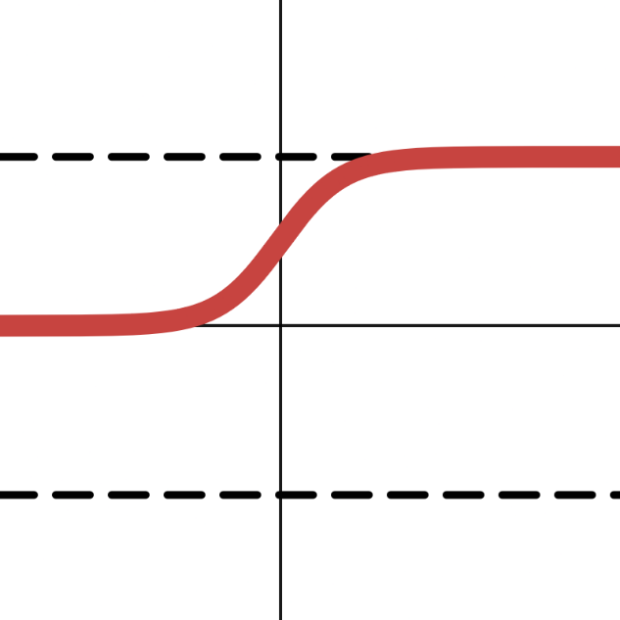
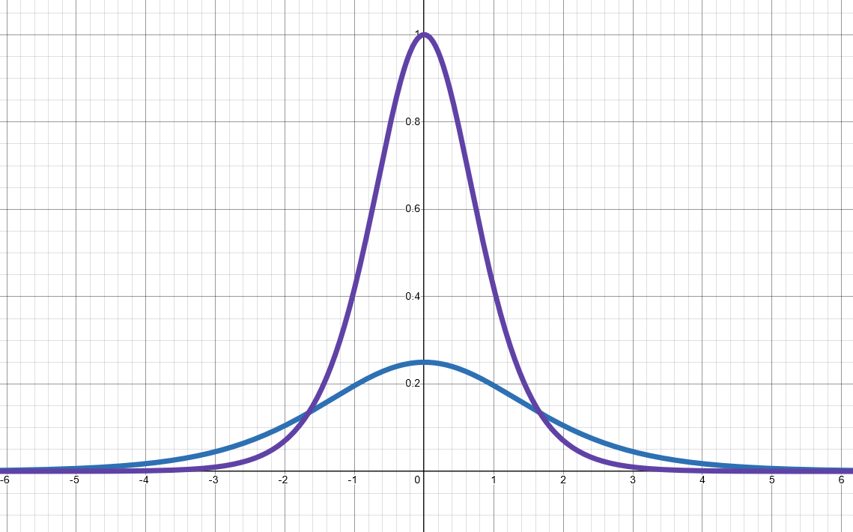
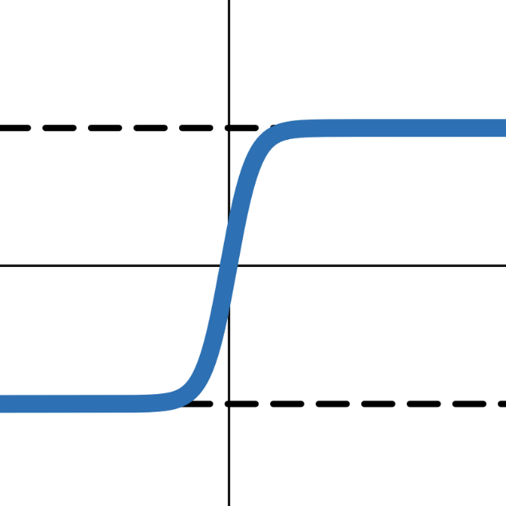


Activation Functions
Gradients
Sigmoid
$$Range= [0,1]$$
Slow to learn (zig-zag search)
Vanishing Gradients
Can still do well for classification or shallow networks
Tanh
Sigmoid
Hyperbolic Tangent (Tanh)
$$Range=[−1,1]$$
Vanishing Gradients, but gradients are larger than Sigmoid

Slide 38
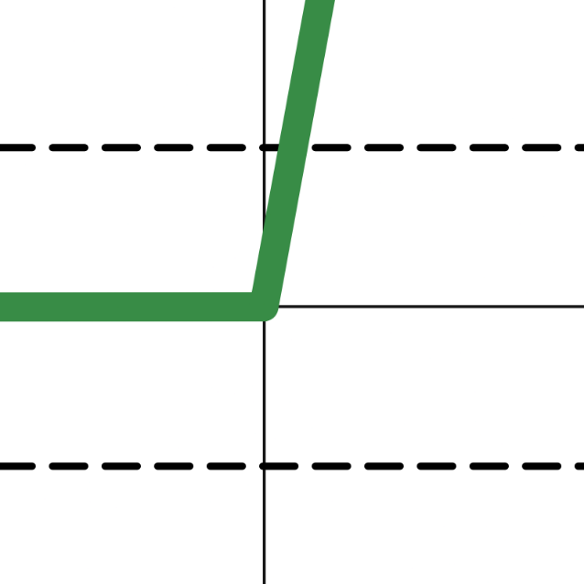
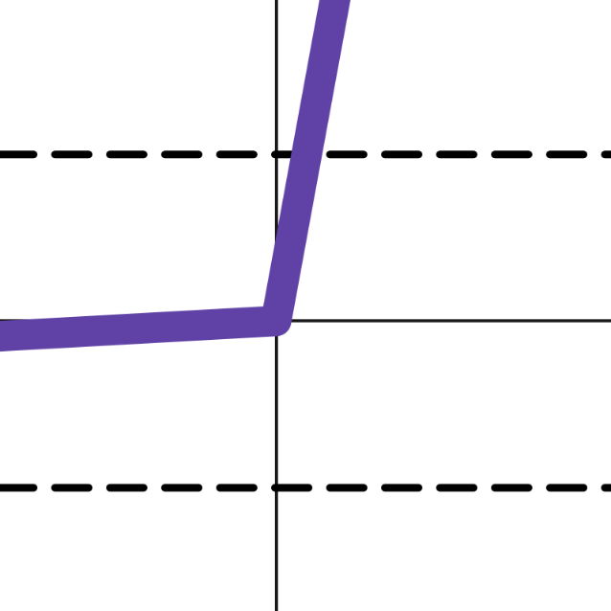


Activation Functions
Rectified Linear Unit (ReLU)
$$Range= [0,∞]$$
Fast and simple to compute
Recommended to start with
Might take longer to approximate smooth functions
“Dying ReLU Problem”
Leaky ReLU
$$Range=[−∞,∞]$$
Fixes “Dying ReLU”

Slide 39


Testing
Regression
$$MAE=\frac{1}{N}\sum_{i=1}^{N}{\left|y_{i}−{\hat{y}}_{i}\right|}$$
$$RMSE=\sqrt{\frac{1}{N}\sum_{i=1}^{N}{{\left(y_{i}−{\hat{y}}_{i}\right)}^{2}}}$$
$$R^{2}=1−\frac{{\sum{\left(y_{i}−{\hat{y}}_{i}\right)}}^{2}}{{\sum{\left(y_{i}−{\overline{y}}_{i}\right)}}^{2}}$$
Where:
$$y_{i}=True outputs$$
$${\overline{y}}_{i}=True {output}^{′}s mean$$
$${\hat{y}}_{i}=Predicted Outputs$$
Classification
$$Accuracy=\frac{TP+TN}{TP+TN+FP+FN}$$
$$Precision=\frac{TP}{TP+FP}$$
$$Recall=\frac{TP}{TP+FN}$$
Where:
TP = True Positive
FP = False Positive
TN = True Negative
FN = False Negative

Slide 40
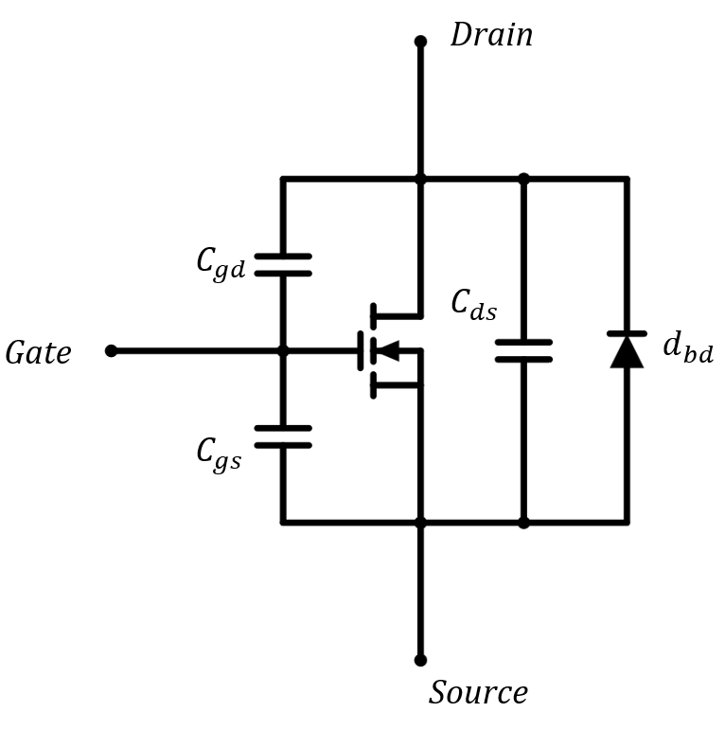
Digital Twin Design: Sensing
Sensing difficulties with resonant tank voltage due to high frequency, EMI, inductors being implicit in the transformer
Sensing difficulties with high speed switch measurements especially slew rates

Slide 41
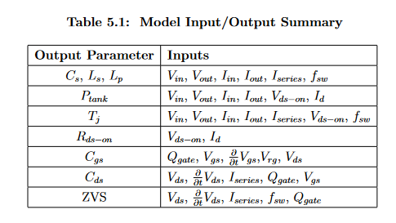
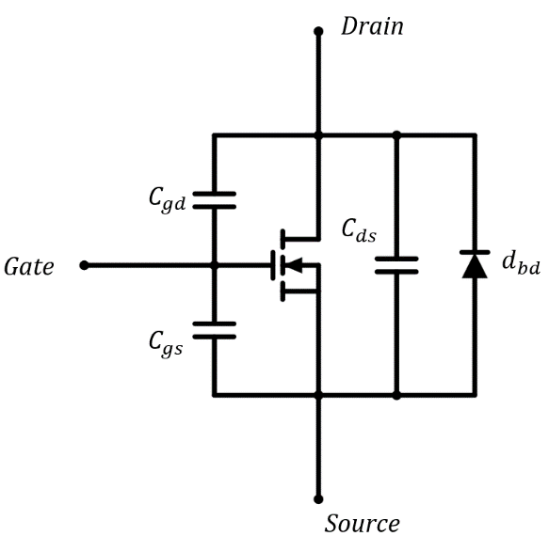
Digital Twin Design

Slide 42
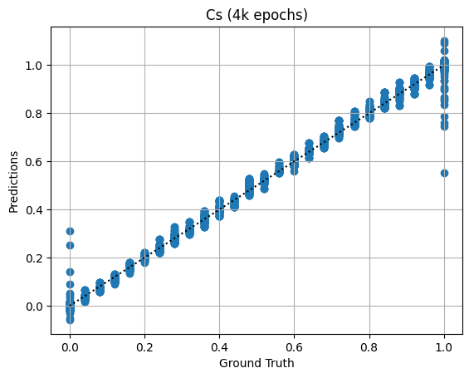


Results

Slide 43



Results

Slide 44



Results

Slide 45



Results
Narrow Dataset to begin with
Scatter plot shows a good fit, even for rare samples away from main peak

Slide 46





Results
Again, Narrow Dataset to begin with
Scatter plot shows a good fit, even for rare samples away from main peak

Slide 47





Results
Boundary predictions can have significant errors. Difference of RMSE to MAE somewhat accounts

Slide 48





Results
Even more significant boundary predictions can have significant errors

Slide 49





Results

Slide 50



Results
Extremely biased dataset
Top ZVS 98% true
Bottom ZVS 98.5% true

Slide 51
Discussion: Boundary Errors

Slide 52

Discussion: Boundary Errors
Expand Ranges to add buffer
Increase Min/Max samples
Modify Loss function

Slide 53


Discussion: Narrow Data
Narrow Distribution of certain data
Force certain configurations of the converter to broaden dataset
Simulation without controller

Slide 54
Discussion: Narrow Data

Slide 55



Discussion: Wide Networks

Slide 56


Discussion: Wide Networks
Name | Inputs | # layers + 2 | Width | LR | Batch Size | Best Epoch | Loss Funct | Optimzer | Activation Function | RMSE | MAE | R^2

Slide 57
Conclusion
Given the model converter, a neural network digital twin was demonstrated to estimate unknown parameters with low error (all below 7% MAE, majority of which were below 3%)
Limitations include related to a smaller dataset of 6k samples, some narrowly ranged parameters. Larger datasets and targeted broadening of certain parameters beyond the chosen ranges may help to better verify this method

Slide 58

Future Work
Real Converter Verification
Implement Real Time FPGA
DT Model Expansions
Preloading Data
GTX 750ti
1.389 PFLOPS FP32
$≈3.13μs$ per sample inference
Different ML Models

Slide 59


Future Work: Model Expansion
DT Model Expansions

Slide 60
Future Work: ML Models
Different ML Models
Time Series Models
Physics Informed Models
Inputs within a window of time
Considers the dynamics
Incorporates known, generalizable physics into training
Reduce data, increase generalizability, encourage learning the physics

Slide 61


Future Work: ML Models
A. Wunderlich and E. Santi, “Digital Twin Models of Power Electronic Converters Using
Dynamic Neural Networks,” in 2021 IEEE Applied Power Electronics Conference and
Exposition (APEC), (Phoenix, AZ, USA), pp. 2369–2376, IEEE, June 2021
G. Rojas-Duenas, J.-R. Riba, K. Kahalerras, M. Moreno-Eguilaz, A. Kadechkar, and
A. Gomez-Pau, “Black-Box Modelling of a DC-DC Buck Converter Based on a Recur-
rent Neural Network,” in 2020 IEEE International Conference on Industrial Technology
(ICIT), (Buenos Aires, Argentina), pp. 456–461, IEEE, Feb. 2020.

Slide 62




Future Work: ML Models
M. Raissi, P. Perdikaris, and G. Karniadakis, “Physics-informed neural networks: A
deep learning framework for solving forward and inverse problems involving nonlinear
partial differential equations,” Journal of Computational Physics, vol. 378, pp. 686–707,
Feb. 2019.
S. L. Brunton, J. L. Proctor, and J. N. Kutz, “Discovering governing equations from data
by sparse identification of nonlinear dynamical systems,” Proceedings of the National
Academy of Sciences, vol. 113, pp. 3932–3937, Apr. 2016

Slide 63
Thank you! Any Questions?

